Slide 1
本质图像论文汇报（七）
汇报人：方阳

Slide 2
Content
1. Intrinsic Scene Properties from a Single RGB-D Image（PAMI2016）

Slide 3
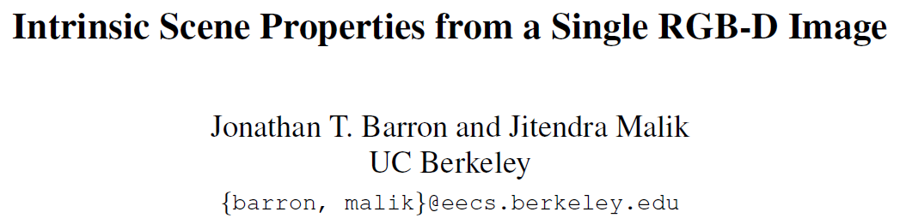

Slide 4
The Limitation of SIRFS
SIRFS considers shapes to be composed of a single smooth depth-map Z, and therefore cannot model depth discontinuities, occlusion
SIRFS has a single global model of illumination L, but natural scenes contain spatially-varying illumination due to attenuation, interreflection, cast and attached shadows
SIRFS uses the occluding contour of the object, information which is not explicit in natural scenes

Slide 5
Scene-SIRFS——extends SIRFS from objects to scenes
use a mixture of shapes and illuminations embedded in a soft segmentation of the scene
use a Kinect depth-map as a surrogate for the information provided by the missing contour cue and to address the inherent limitation of shading for low-frequency shape reconstruction
Notes:
使用混合形状和照明嵌入到场景的软分割
使用Kinect深度图代替缺失轮廓线索提供的信息，并解决低频形状重建中阴影的固有限制

Slide 6
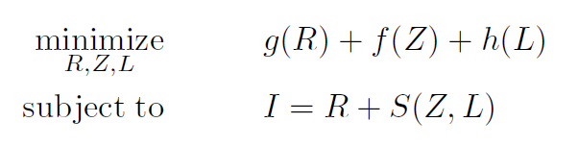
SIRFS review
Notes:
其中$R$为log-reflectance image，$Z$为depth-map，$L$为27维的球面谐波Illumination向量。$S(Z, L)$是一个渲染引擎，它的作用是将$Z$线性化一组表面法线，然后通过这些表面法线和L构成log-shading，$g(R), f(Z)$ 和 $h(L)$分别为反射，形状，光照的损失函数。

Slide 7
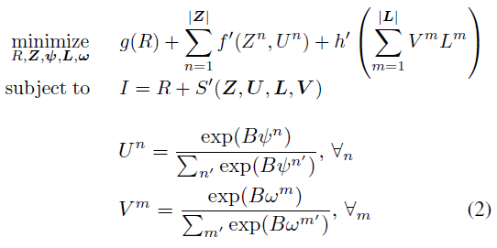
Scene-SIRFS

Slide 8
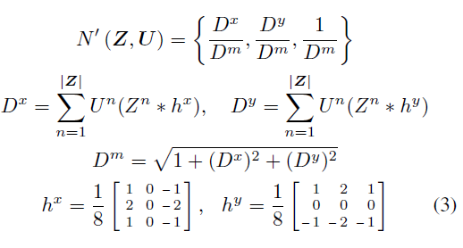
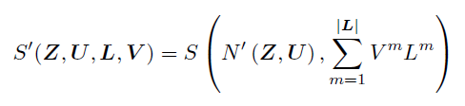

Slide 9



Shape Priors and Kinect Images

Slide 10
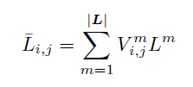

Illumination Priors

